Slide 1
Project E update: Overleaf

Slide 3
A number of workshops (webinars) have been provided by Overleaf to inform Users of the functionality and promote the use of the Pro licences
Over c.400 Registrations & c.200 attendees
A designated webpage has now been launched and is held on the Libraries’ Website: https://www.library.manchester.ac.uk/using-the-library/staff/research/overleaf/
UoM themed templates (e.g. Course thesis) ​have been uploaded to the Overleaf site and are accessible to all Users, irrespective of user group
Professional Licence
Open Source (Free Licence)
Fully supported by IT Services with processes in place to deal with any queries

Slide 4
Since the official launch of Overleaf Commons for the Research Community at the University data and statistics have been recorded on a daily, weekly and monthly basis.
Metrics show a significant amount of usage, growth and uptake during the first year with over 2,900 confirmed affiliated Users as of the end of January 2021, an increase of c1,600 since it’s launch

Slide 5
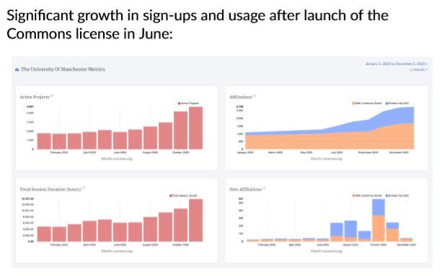

Slide 6
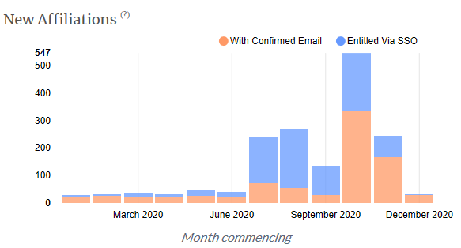

Slide 7
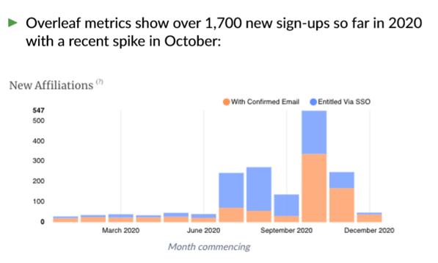
Overleaf metrics show over 1,800 new sign ups with a spike in take up following the intake in October

Slide 8
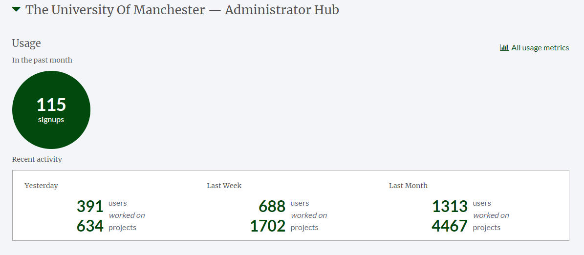
383
2 months
383

Slide 9
- Headline Summary
Over 2900 Affiliations​
An increase of more than 1600 since launch​
c .1,300 Active Users​
An increase of >800​
c.4700 Active Projects ​
An increase of c.2800​
c.2,200 New Projects​
An increase of >1,600

